Slide 1
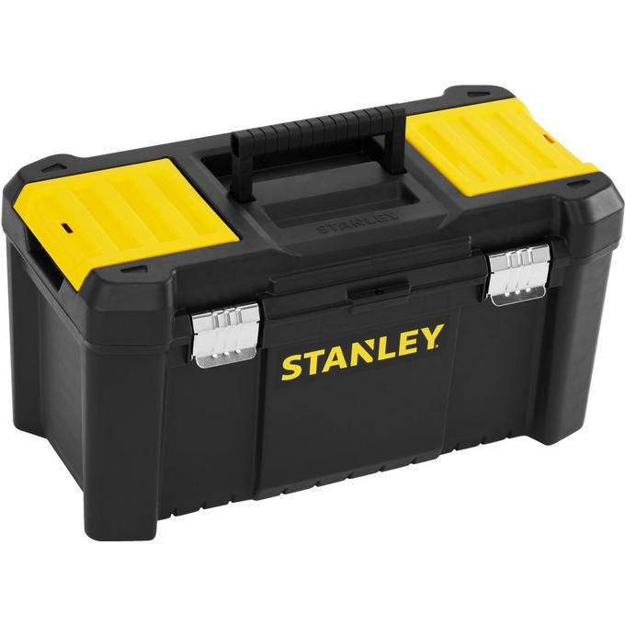
Let’s build up your support toolbox

Slide 2
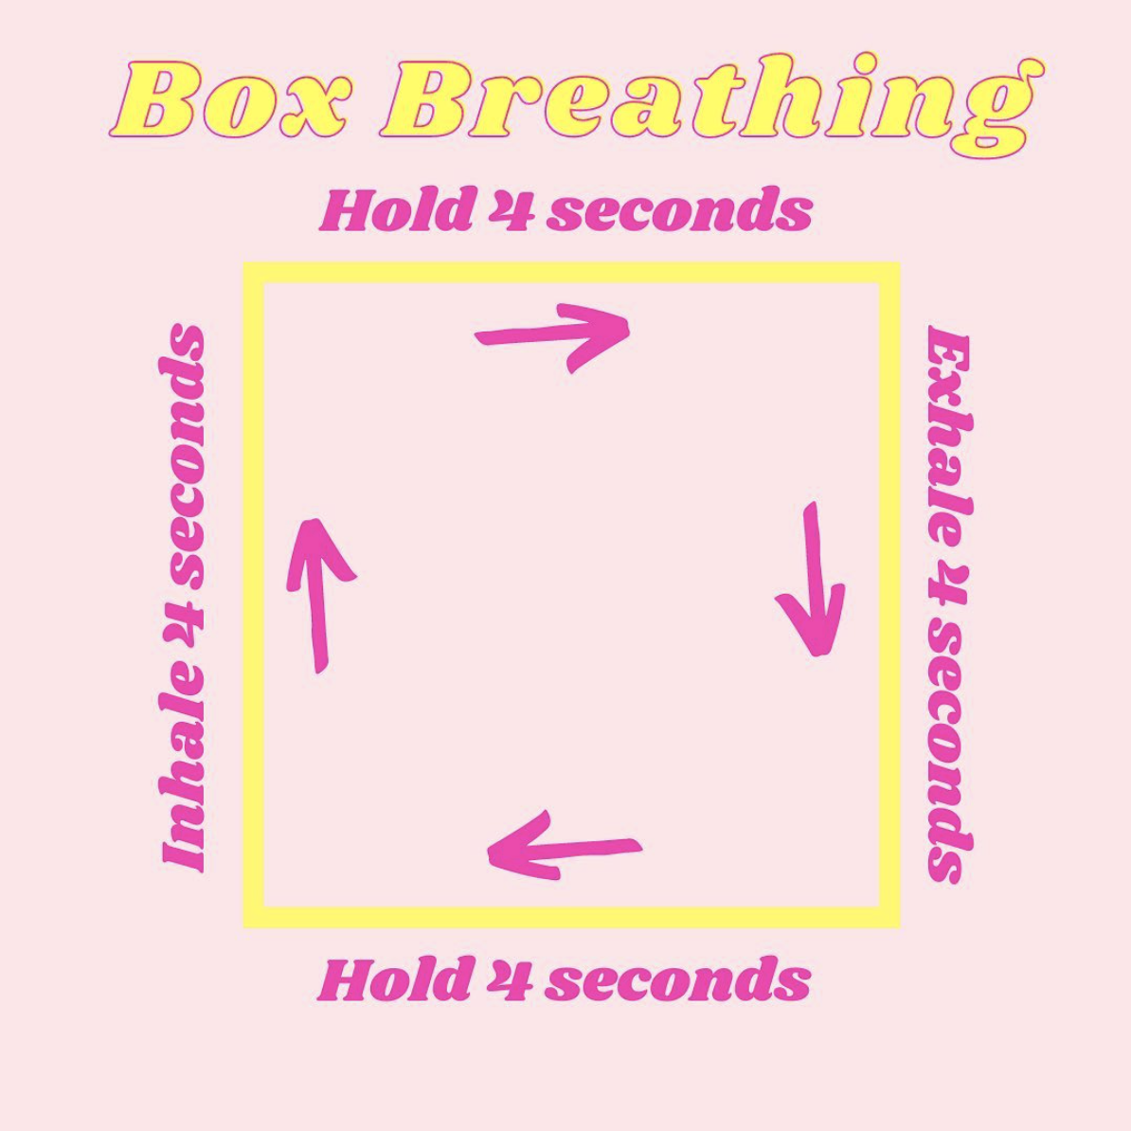
Visualize a box. Take a deep inhale for 4 seconds as you breathe up the box. Hold your breath for 4 seconds and visualize moving across the box. Slowly exhale for 4 seconds as you move down the box. And then hold for another 4 seconds as you move across, completing the box.
Repeat 4 times!
Bonus cool factor: this technique is used by Navy SEALs because it helps to improve concentration, enhance performance, reduce stress, and improve your mood.

Slide 3
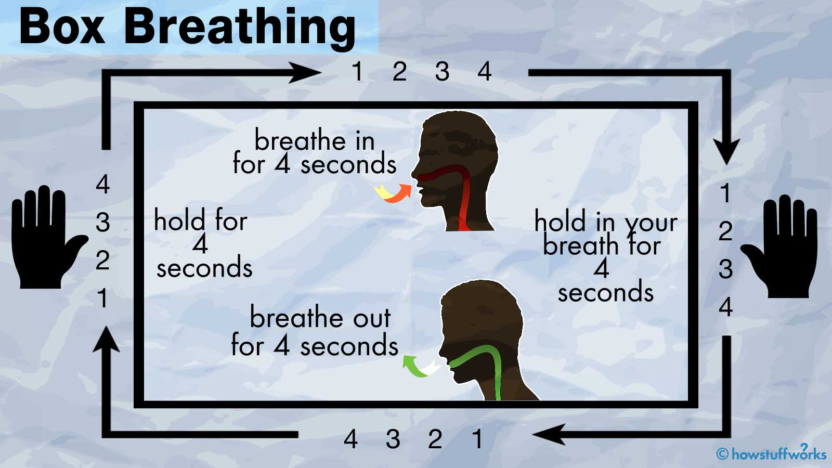

Slide 4
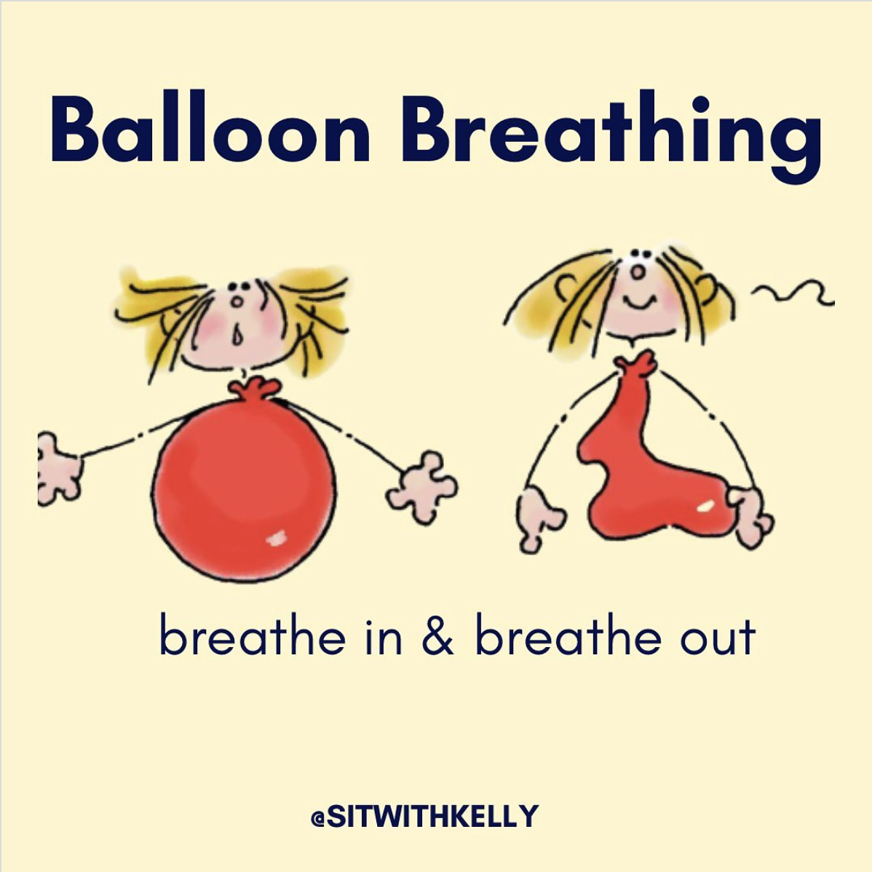
Get comfortable in your chair or on the floor. Put your hands on your belly and imagine that your belly is a balloon.
Take a deep breath in and imagine the balloon filling with air. Take a long slow breath out and imagine the balloon deflating and getting smaller.
Repeat 10 times, or until you feel ~calm~.

Slide 5
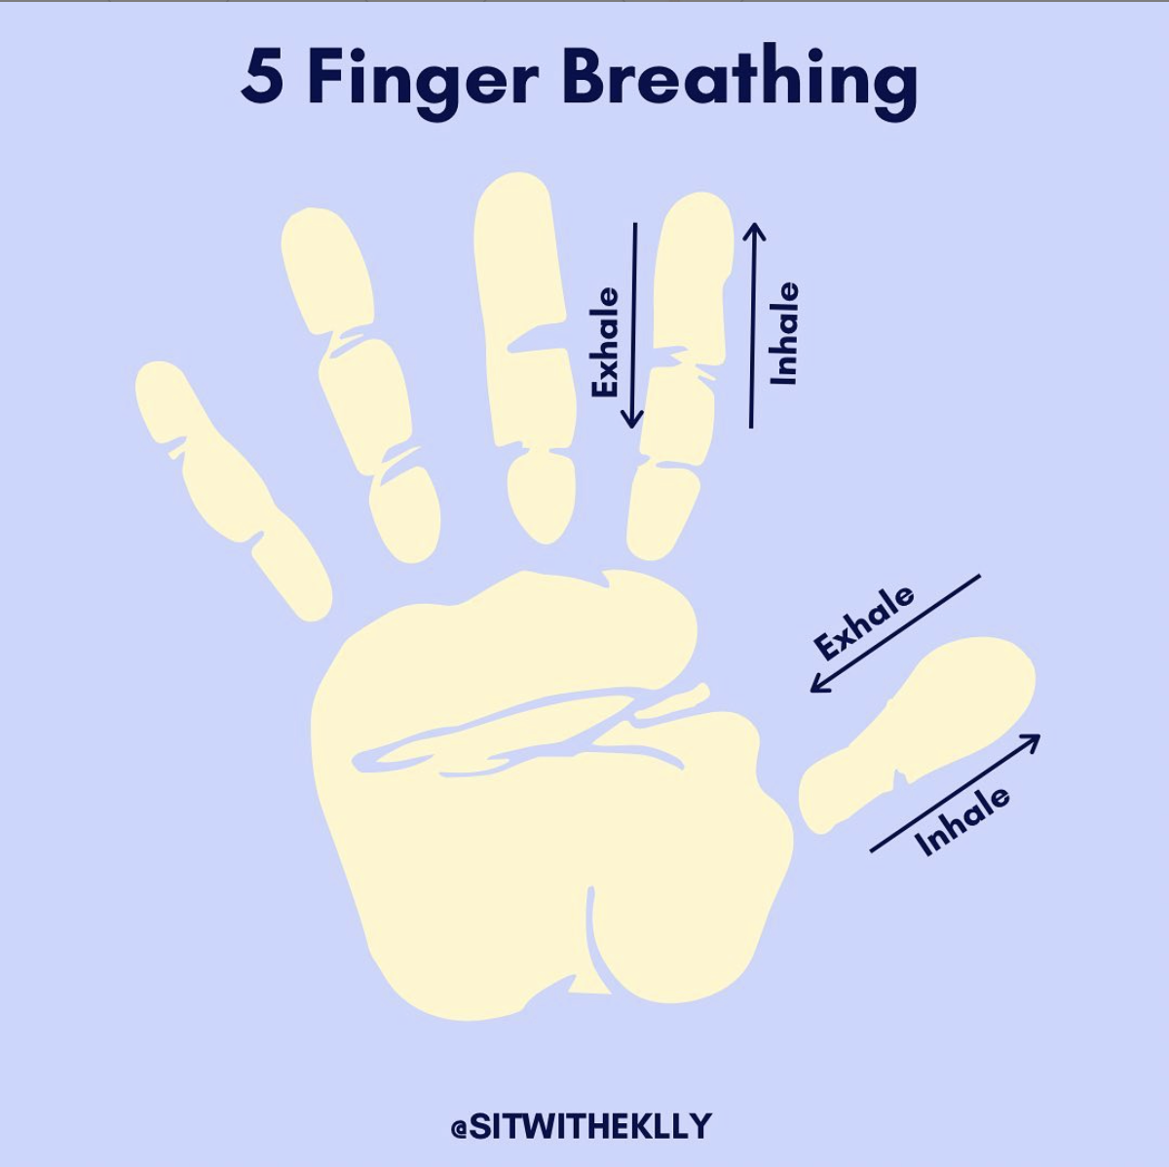
Hold your hand up in front of you. Take your pointer finger and start at your thumb. Trace your finger up your thumb, taking a deep breath in. Slowly trace your finger down the side of your thumb as you take a long exhale.
Continue tracing your way up and down each finger, as you take slow, long breaths in and out. Trace your whole hand at least 2 times.

Slide 6
Soothing Techniques
T - Tip the temperature of your face with cold water to calm down fast.
I - Intense Exercise
P - Paced Breathing
P - Progressive Muscle Relaxation

Slide 7

Tip the temperature of your face with cold water
Cooling down can be a highly effective way to help calm your emotions. Splashing water on your face can help to calm anxiety by diverting the brain’s attention, as well as helping to ground you in your body.
Holding your breath, dip your face in a bowl of cold water; keep water above 50 degrees. Or hold a cold pack or ziplock bag with ice water on your eyes and cheeks or splash cold water on your face.

Slide 8

Mindful Movement
Movement can help to decrease tension, elevate and stabilize mood, improve sleep, and improve self-esteem. When done mindfully, it can bring us back to the moment and help us focus on what is there in front of you.
When done mindfully, the simplest exercise can support feelings of being present.
2 to 5 minutes. This can be walking, star jumps, running, or balancing on one leg, clenching and releasing a fist, shrugging your shoulders

Slide 9
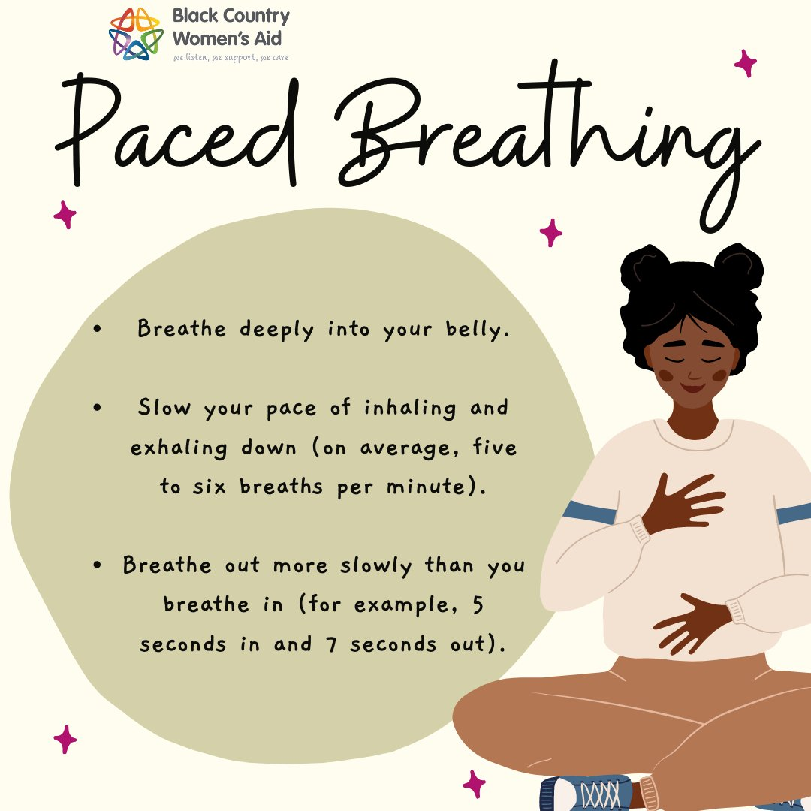
Paced Breathing
Practicing paced breathing can help to ground your body as well as regulate a heightened heart rate.
Slow your pace of breathing way down by breathing deeply from the abdomen. Breathe out for longer than you breath in. For example, if you breathe in for four seconds, breathe out for eight. Do this for 1-2 minutes to bring down elevated emotions.

Slide 10
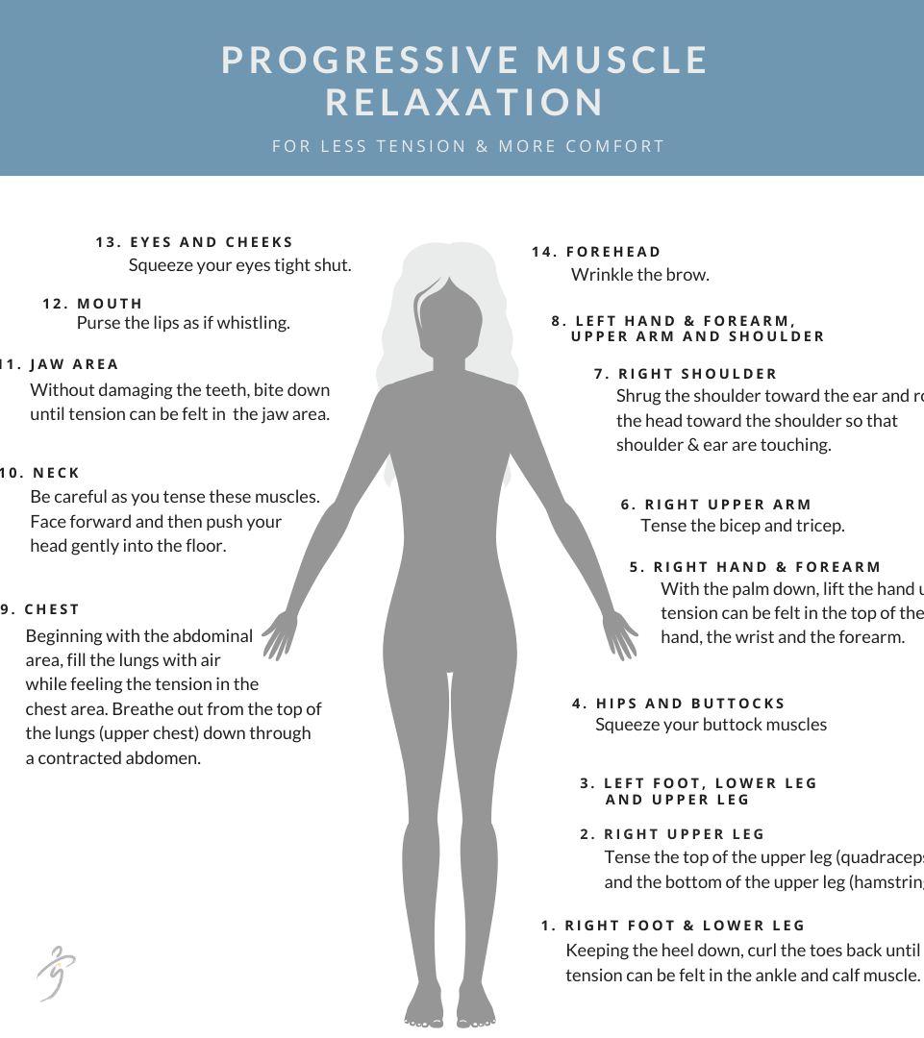

Progressive Muscle Relaxation
By taking time to focus on where your body stores tension and releasing that tension, you will be better able to ground and centre yourself within your environment. This also helps to acknowledge what your body is feeling.
Tense and relax each muscle group, head to toes, one muscle group at a time. Tense for five seconds, then let go; relax the muscle all the way. Notice the tension; notice the difference when relaxed. As you relax each muscle, say to yourself, “relax.”
Example of free resources:
PMR (Progressive Muscle Relaxation) to Help Release Tension, Relieve Anxiety or Insomnia – YouTube or
Insight timer app

Slide 11
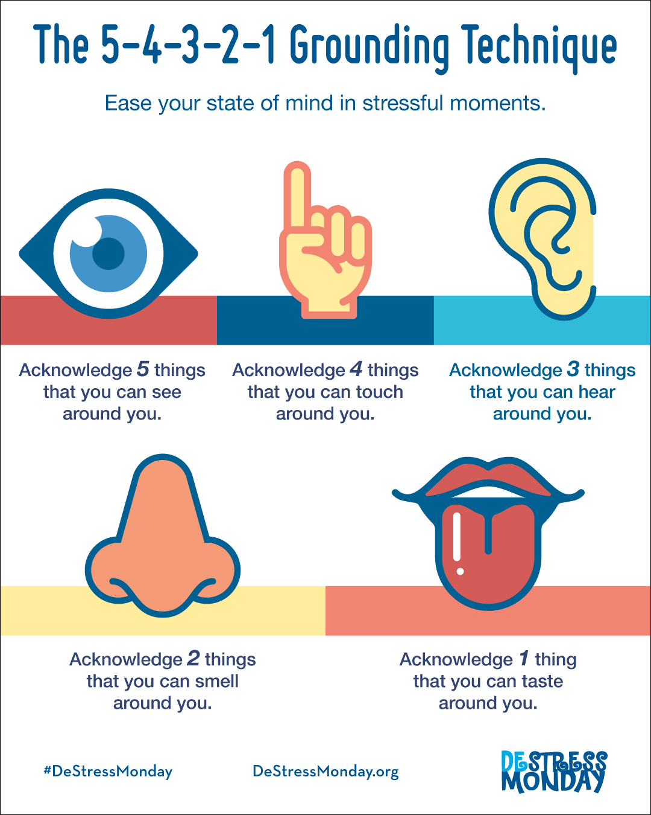
Your Grounding Techniques
Think of:
5 things you can see
4 things you can touch
3 things you can hear
2 things that you can smell
1 thing you can taste

Slide 12
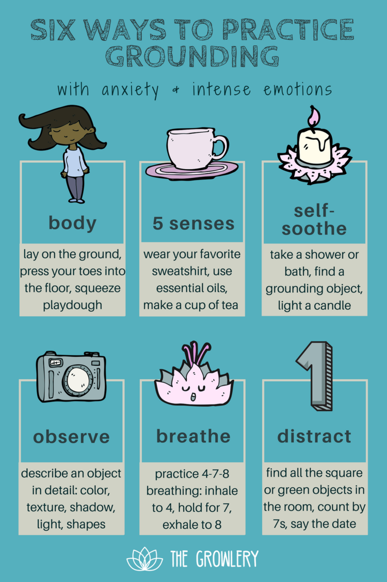
Other Grounding Techniques

Slide 13
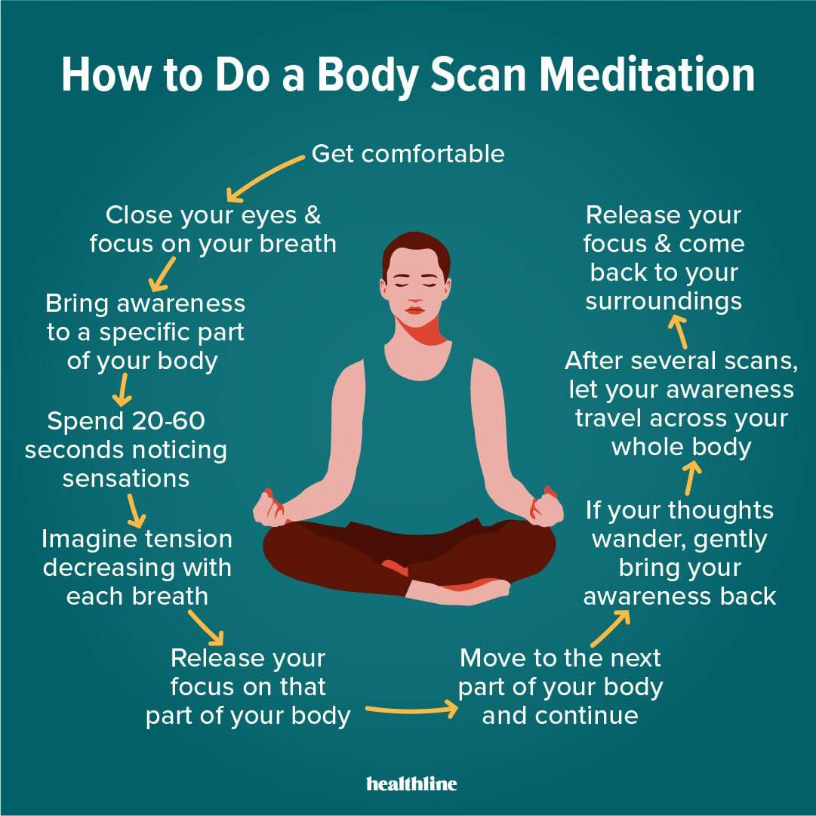


Identifying Feelings and bodily sensations
Youtube - free resources:
Body scan : Body Scan with Salva Chak, MPH - 15 Minutes | Surgeon Well Being | ACS – YouTube
Mindfulness Exercise: Body Scan – YouTube
Apps for your mobile (may have in-app purchases):
            Calm app,
            headspace app,
            insight timer app

Slide 14
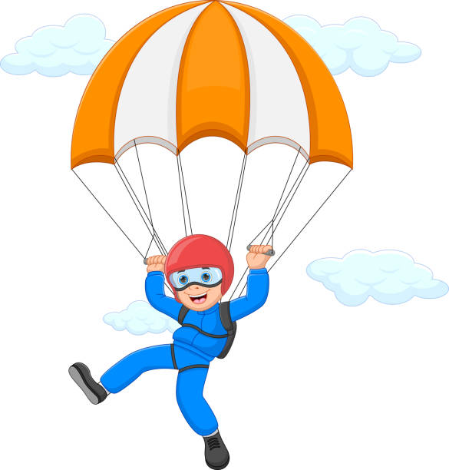
Remember: practice is important!

Slide 15
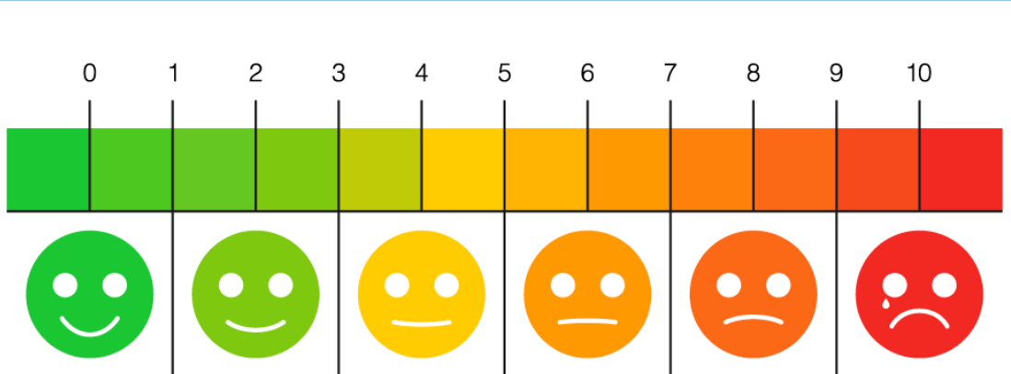
Confidence in managing ………………. ? (before)

Slide 16
Confidence in managing ………………….? (after)

